Slide 1
Plan Your Future
Post Secondary Education and Training Options
NDE Innovative Grant in collaboration with NDE and ESU 13

Slide 2
A committee of Professionals have planned a series that will help you Explore and Prepare for Post-Secondary Options
4 Sessions:
Post-secondary Training and Educational Options
Financial Supports for College
Supports Available in Post-Secondary SEttings
Skills Needed for Post-Secondary Settings
Committee
Dave Brandt; Winahead; Pam Brezenski, ESU 13; Pat Comfort, NE Department of Labor; Nicole Fisher; NE VR, Andrew Hunzeker, Education Quest; Ashley Meyer, NE Autism Network/ESU 13; Bill Moore, LifeLink NE; Norm Stephenson; WNCC Disability Support Services

Slide 3
Group Norms
Be Present
Phones off and away, please
Share-Participate, It’s a safe Place!
Respect Everyone’s View
Remember, we all may see different things!
To make this work………

Slide 4
Financial Supports in College
Nicole Fisher, NE VR
Andrew Hunziker, Education Quest
Sheila Johns; WNCC Financial Aid
David Lashley; Gering High School Counselor

Slide 5
What is the Key Difference?
Scholarships
FREE money
Grants
FREE money
Loans
You PAY it back!
Parent Plus loans are available-parent debt
Work Study
You still have apply and get hired!
Work the hours THEN get paid.
What did you learn?

Slide 6
What is the Key Difference Between Subsidized and Unsubsidized Loans?
Subsidized:
Federal government pays interest while you are in school.
Un-Subsidized:
Interest is charged while you are in school. You pay at the end.
What did you learn?

Slide 7
What Forms Do I need to Fill out for these items?
Scholarships
Required forms vary for different scholarships
Multiple Applications
Scholarship Quest
Grants
FAFSA
Work Study
FAFSA
*Based on work study need/may be eligible at one school, but not another
Loans
FAFSA
What did you learn?

Slide 8
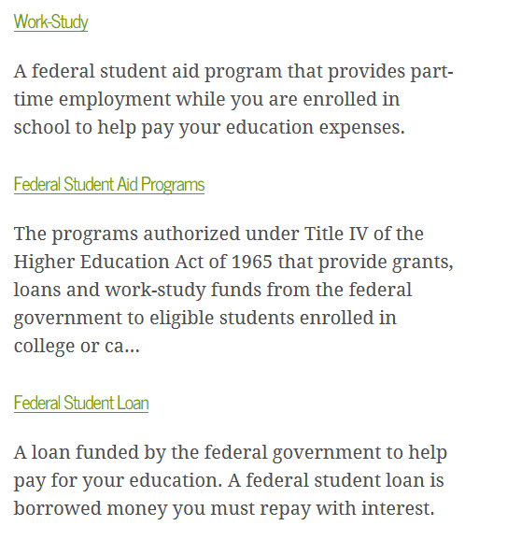
What is the FAFSA?
The Free Application for Federal Student Aid (FAFSA) is a form that can be prepared annually by current and prospective college students (undergraduate and graduate) in the United States to determine their eligibility for student financial aid.
What did you learn?

Slide 9
Where Do I find Scholarships?
School Counselor Office
Scholarship Quest/Education Quest
Internet Searching
Colleges
What did you learn?

Slide 10
What Do I need to Know about Loans?
Student Responsibilities
You HAVE to pay the money back-defaulting can affect your credit
If you drop below ½ time status, repayment begins
Must maintain acceptable academic status
What did you learn?

Slide 11
When Do You Apply
It varies based on which application you complete!
Scholarships
Any Point
Watch Due Dates
Grants, Work Study, Loans (FAFSA)
Opens in October Fall Prior to attending
One Year Prior
Pay Attention to the Priority Deadline Per College
What Did You Learn?
This is a recent change!!!

Slide 12
What Do I need for the FAFSA?
Opens on October 1st
Previously Jan 1st
Get Information Sooner
3 Months Sooner
Tax Information for Prior Year
Import Tax Information Directly to FAFSA
Andrew Hunzeker; Education Quest Can Help
FAFSA Nights; Education Quest
What Did You Learn?

Slide 13
Where Do I Start
School Counselor
-Talk to your School counselors
-Mini assemblies throughout the year.
Education Quest
-Invited into schools for a Financial Aid Meeting
-Parents can contact Andrew Hunzeker directly
Colleges
-Check on scholarships at colleges, some colleges have one application for ALL scholarships
-Include the colleges on the FAFSA report so that information can be sent
-Reminders of events and other supports throughout the year.
-Parents may be able to attend!
-Informational meeting at the beginning of the year.
-Parents give the school contact information for events and supports
What Supports are Provided!
**Recommended to have a separate email PARENTS and STUDENTS can BOTH access

Slide 14
What resources can NE VR provide for Assistance
Must be eligible for a career plan!
If the vocational plan includes post-secondary training, they MAY be able to provide financial support
Based on available jobs/match to direction
Varies from individual to individual
MUST get connected with NE VR
Go to Case Manager
Connect with a Pre-ets provider
MUST be in a priority that is being served
Based on funding
MUST maintain 2.0 GPA
What Did You Learn?

Slide 15
OK! So, where do I go from here?
Decided on Schools-Training Programs
Apply for the Schools: They may send materials
Search for additional scholarships; Apply
Complete FAFSA
Summary of Steps!
NE VR
Case Manager
School Counselor
Education Quest Website
Parents
Case Manager
School Counselors
Education Quest
Parents
Case Manager
School Counselors
Education Quest/Scholarship Quest
Colleges
Internet
Parents
School Events
Education Quest
Parents

Slide 16
Resources You May need

Slide 17
Federal Student Aid
https://studentaid.ed.gov/sa/about

Slide 18
NE VR
505 Broadway, Scottsbluff, NE 69361
(308) 632-1321
http://www.vr.nebraska.gov/

Slide 19
Education Quest
1601 E 27th St, Scottsbluff, NE
(402) 479-6658
AndrewH@educationquest.org
https://www.educationquest.org/11th-12th-grade-students/

